Slide 1

PEOPLE'S DEMOCRATIC REPUBLIC OF ALGERIA
الجمهورية الجزائرية الديمقراطية الشعبية
MINISTRY OF HIGHER EDUCATION AND SCIENTIFIC RESEARCH
وزارة التعليم العالي و البحث العلمي
Final Year Project
In order to obtain the Engineer’s degree
Real-time transfer of payload data
based on spatial communication standards
Presented By:
Bilal Sid Ahmed BELDJENNA
Akram SBAIHIA
Supervised By
Dr. Redouane BELBACHIR
Dr. Amine MEGHABBER
Examiners
Mrs. Amel BOUMEDJOUT
Mrs. Nawel BENDIMERAD

Slide 2
01.
Introduction
---
2

Slide 3



Introduction
Higher Data Volume and Complexity
Need for Efficient Protocols
Importance of Real-Time Transfer
3
Notes:
Knowing that the development of space exploration and satellite technology increased the volume and complexity data transmited between the satellite and ground stations .
So for data transfer missions to be successful we need an efficient protocole where real time data transfer can be critical.

Slide 4
02.
Problematic
---
4

Slide 5
Problematic
How can we ensure reliable real-time data transfer of the payload data (satellite image) between earth observation satellites and ground station ?
5
Notes:
And this brings me to the problem we are going to discuss in this dissertation
Which is ……

Slide 6
03.
Proposed Solution
---
6
Notes:
And our challenge is to propose a solid solution for this problematic

Slide 7
Proposed Solution
Challenge: Develop an embedded system (software + firmware) capable of real-time transfer of a segmented satellite image.
7
Notes:
Our idea to develop an embedded system which is a firmware and a software and that`s what makes it a complete system, compute in real time and capable of transferring the image segements

Slide 8
Proposed Solution
Protocol Implementation: Implement the CCSDS Protocol using a low-level programming language to packetize the segmented image data.
8
Notes:
The protocol we are gong to implement is the ccsds protocol particularly the space packet protocol where we are going to encapsulate the segments and packetize it which brings us to our final purpose or objective

Slide 9
Proposed Solution
Objective: Reconstitute the image (Payload data) at the ground station from the transmitted packets.
9
Notes:
Where our software is going to reconstitute the transmitted image so in our case the payload data is a satellite image
But before that we need to understand some points

Slide 10
04.
Plan
---
10
Notes:
Our presentation plan is as follows

Slide 11



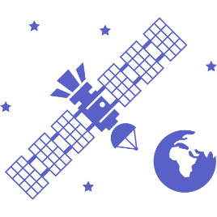
Plan
Control of Earth Observation Satellites
Contribution
CCSDS Protocol
Space Missions
11
Notes:
We are going to explain briefly some key concepts about space missions as well as the control of earth observation satellites and the protocol that we implemented in our project the ccsds before jumping to our contribution

Slide 12
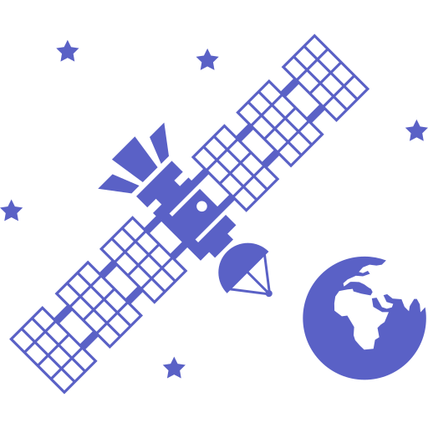
Space Missions
12

Slide 13
05.
What’s a space mission ?
---
13

Slide 14
What’s a space mission ?
A space mission is a coordinated effort to explore space or accomplish particular goals beyond Earth's atmosphere. It involves sending a spacecraft, like a satellite or rover, into space using a rocket.
14
Notes:
A space mission is the effort that is oriented towards accomplishing goals beyond earth atmosphere via a satellites or rovers

Slide 15
Space Mission Types
Communications and Navigation Missions
Earth Observation Missions
Astronomy and Space Science Missions
15
Notes:
There is three types of space missions the first one is communications and navigation missions in order to provide communication services
The second one is earth observation missions for monitoring specific areas like weather satellites or military spy satellites
The third type is astronomy and space missions for exploring our universe

Slide 16
Deployed Orbits
LEO
MEO
HEO
GEO
16
Notes:
satellite can be deployed in three types of orbits:
Geostationary orbits is located about 35786 km above the equator of the planet, satellites deployed in this orbit rotate at the same speed as the earth, so they are perfect for applications that need continuous coverage
Medium earth orbits usually ranging from 2000 and 35786 km above earth and they are ideal for application like communication, navigation
Low earth orbits situated between 160 and 1000 km above earth and generally earth observation satellites are deployed in this orbit

Slide 17
06.
What’s an Earth Observation Satellites?
---
17

Slide 18
What’s an Earth Observation Satellites?
Also known as Earth remote sensing satellites.
Designed to collect data about the Earth's surface.
The most common type are Earth imaging satellites.
Environmental monitoring, meteorology.
18
Notes:
From so on we are going to focus on one type of satellites which is the earth observation satellites where ………

Slide 19
07.
Satellite Subsystems
---
19

Slide 20





Satellite Subsystems
Communication Subsystem
Power Subsystem
Thermal Control Subsystem
Payload Subsystem
Propulsion Subsystem
20
Notes:
The primary subsytems of a satellite are:
Communication subsystem used to transfer and receive data from ground stations
Payload subsystems include sensors and cameras used by the satellite to capture informations
Power subsystems include solar panels that transform solar energy into electrical power and batteries to store energy in order to use it when the satellite cannot receive solar energy
Propulsion subsystem controls the satellite motion in space both in term of orbits and orientation
Thermal control subsystems includes electric heaters and radiators to keep the satellite temperature stable

Slide 21
Control of Earth Observation Satellites
21
Notes:
Now, let`s move to the next part where we explain the control of these earth observation satellites and how to communicate with them

Slide 22
08.
Uplink and Downlink
---
22
Notes:
Uplink and downlink are two important terms to understand , where

Slide 23



Uplink & Downlink
Uplink
Downlink
23
Notes:
Uplink refers to the transmission of signals from ground station to satellites,
and downlink involves the transmission of signals from the satellite back to a ground station

Slide 24
09.
Communication Between Satellite and Ground-Station ?
---
24
Notes:
This communication between satellite and ground station is done usually through two different transmission channels

Slide 25
Communication Between Satellite and Ground-Station ?
Two separate channels
Payload Data
Telemetry, Tracking, and Command (TT&C)
25
Notes:
A channel for the transmission of payload data and a channel for telemetry, tracking and command which we are going to talk about in the next slide

Slide 26
10.
Telemetry, Tracking and Command (TT&C)
---
26

Slide 27

Telemetry, Tracking and Command (TT&C)
RNG
TC
PDT
TM
TT&C Ground Station
Mission Operation Center
Payload Data Center
Payload Ground Station
27
Notes:
TT&C has three primary functions:
Command (TC): Earth to space transmissions.
Telemetry (TM): Space to Earth transmissions.
Tracking (RNG): To estimate the spacecraft's distance and speed.

Slide 28
11.
Payload data
---
28

Slide 29
Payload data
collects and downloads the satellite's primary mission data, such as high-resolution images.
Data is transmitted in the X-band for higher rates and large files over 1 GB.
Processing ranges from raw telemetry to value-added products ready for end-users (Reconstructed Image).
29

Slide 30
CCSDS Protocols
30
Notes:
CCSDS stands for Consultative committee for space data systems and they are an organization responsible for making multiple standards when it comes to space communication including the space packet protocole which we are going to talk about in the next slides

Slide 31
12.
SPP Protocol
---
31

Slide 32






SPP protocol
32
Notes:
The space packet protocole is a framework for sending space packets , it is quit flexible and can handle different sizes and types of data
The construction of a space packets (telemetry packets) goes through three phases in a layered architechture starting with the packetization layer

Slide 33
Packtization Layer
33

Slide 34
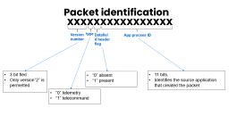
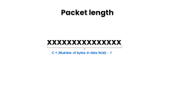
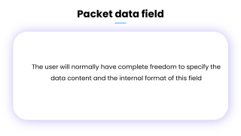
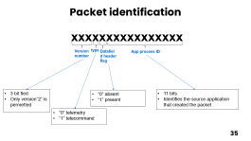
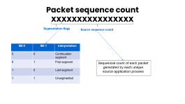
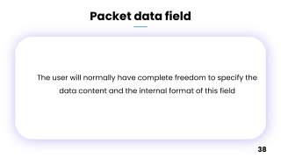
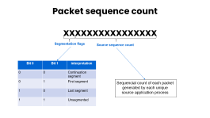
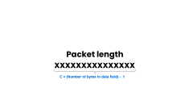
Source packet format
Packet identification
Packet sequence control
Packet length
Packet header
Packet data field
34

Slide 35
Packet identification
xxxxxxxxxxxxxxxx
Version number
type
Datafield header flag
App procees ID
3 bit fied
Only version”2” is permetted
“0” absent
“1” present
11 bits.
Identifies the source application that created the packet .
“0” telemetry
“1” telecommand
35

Slide 36
Packet sequence count
xxxxxxxxxxxxxxxx
Segmentation flags
Source sequence count
Bit 0 | Bit 1 | interpretation
0 | 0 | Continuation segment
0 | 1 | First segment
1 | 0 | Last segment
1 | 1 | Unsegmented
Sequencial count of each packet generated by each unique source application process
Notes:
Segmentation flags takes Different values for each segment according to their order

Slide 37
Packet length
xxxxxxxxxxxxxxx
C = (Number of bytes in data field) - 1

Slide 38
Packet data field
The user will normally have complete freedom to specify the data content and the internal format of this field
38

Slide 39

SPP protocole

Slide 40
Segmentation Layer
40

Slide 41
Telemetry packets
Telemetry Packets are used to prevent longer Source Packets from dominating the channel over shorter ones
41

Slide 42
Telemetry packets
Packet identification
Packet sequence control
Packet length
Packet data field
Packet header
Data segment
Packet header
Data segment
Packet header
Data segment
Packet header
Data segment
Packet header
Data segment
L = ( m * LSEGMENT) + R
42
Notes:
all source packets with data field exceeding a prescribed length are segmented into several shorter telemetry packets and if there is any residue the last packet will be shorter than the others

Slide 43
SPP protocole

Slide 44
Transfer Layer
44

Slide 45
Transfer frame
The general format consists of:
Primary header
Secondary header(optional)
Data field
Trailer(optional)
45

Slide 46
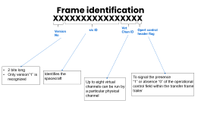
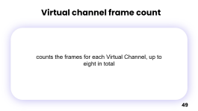
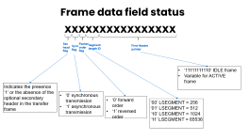
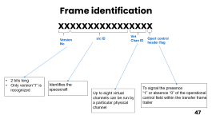
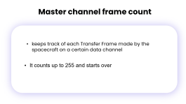
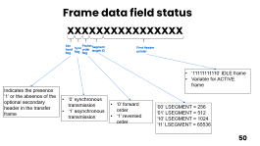
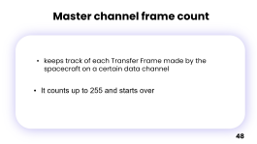
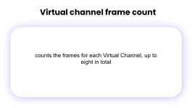
Transfer frame primary header
Sync marker
Frame identification
Master channel frame count
0x1ACFFC1D
Virtual channel frame count
Frame data field status
46

Slide 47
Frame identification
xxxxxxxxxxxxxxxx
s/c ID
Virt Chan ID
Opert control header flag
Version No
2 bits long
Only version”1” is recognized
Identifies the spacecraft
To signal the presence
“1” or absence “0” of the operational control field within the transfer frame trailer
Up to eight virtual channels can be run by a particular physical channel
47

Slide 48
Master channel frame count
keeps track of each Transfer Frame made by the spacecraft on a certain data channel
keeps track of each Transfer Frame made by the spacecraft on a certain data channel
It counts up to 255 and starts over
48

Slide 49
Virtual channel frame count
keeps track of each Transfer Frame made by the spacecraft on a certain data channel
counts the frames for each Virtual Channel, up to eight in total
49

Slide 50
Frame data field status
xxxxxxxxxxxxxxxx
Sec head flag
Sync flag
Packet order flag
Segment length ID
First Header pointer
‘11111111110’ IDLE frame
Variable for ACTIVE frame
Indicates the presence ‘1’ or the absence of the optional secondary header in the transfer frame
‘0’ synchronous transmission
‘1’ asynchronous transmission
‘0’ forward order
‘1’ reversed order
‘00’ LSEGMENT = 256
‘01’ LSEGMENT = 512
‘10’ LSEGMENT = 1024
‘11’ LSEGMENT = 65536
50

Slide 51

Contribution
51
Notes:
So, this brings us to our contribution

Slide 52
Problematic Reminder
How can we ensure reliable real-time data transfer of the payload data (satellite image) between earth observation satellites and ground station ?
52

Slide 53
13.
Requirements Identifications
---
53

Slide 54
Requirements Identifications
Non-Functional Requirements
Functional Requirements
Image Segmentation
Reliability
CCSDS Packetization
Scalability
Real-time Data Transfer
Compatibility
Image Reconstitution
Extraction of Headers and Auxiliary Data
54

Slide 55
14.
Main Challenge
---
55

Slide 56



Main Challenge
56
Notes:
The Arduino kit will simulate the earth observation satellite and the ground station will be simulated by a desktop software and they will communicate with each other via serial port

Slide 57
Main Challenge
57

Slide 58
15.
Hardware Architecture
---
58

Slide 59
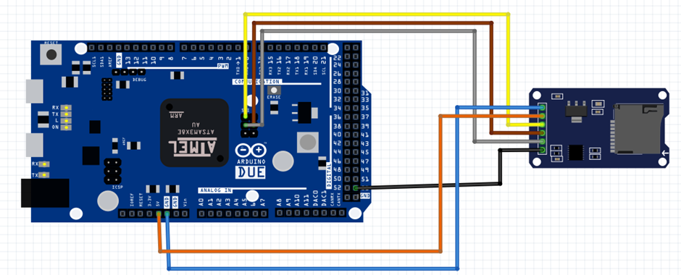
Hardware Architecture
SD Card Shield SPI Module
Arduino Due Board
59
Notes:
For the hardware we used an Arduino kit and an sd card shield connected to the , spi pins on the Arduino

Slide 60
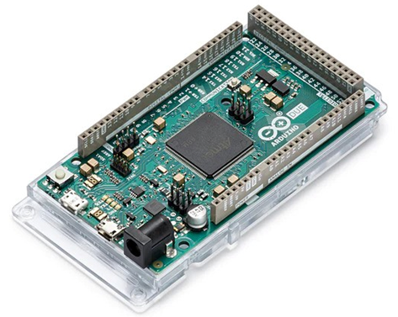
Hardware Architecture
54 Digital Inputs
12 Analog Inputs
2 Digital-to-Analog Converters (DAC)
2 Controller Area Network (CAN) interfaces
Arduino Due Board
60

Slide 61
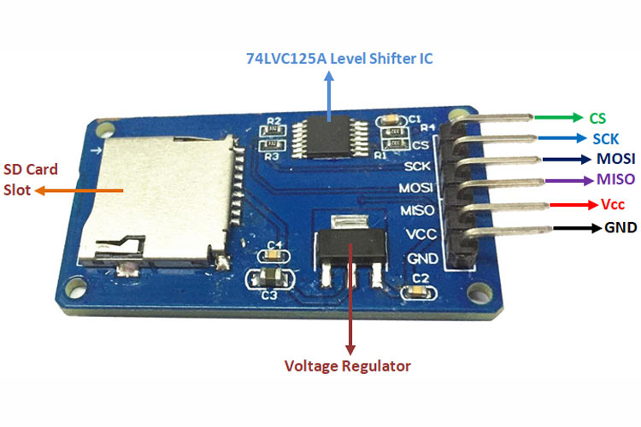
Hardware Architecture
CS
Control Pin
SCK
accepts clock pulses from master
MOSI
SPI Input
MISO
SPI Output
VCC
Provides power
SD Card Shield SPI Module
GND
Ground Pin
61

Slide 62
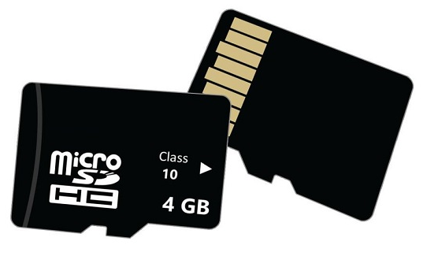
Hardware Architecture
FAT32 SD Card
62
Notes:
The sd card will be used to store the images

Slide 63
16.
Software Architecture
---
63

Slide 64
Software Architecture
Firmware Developement
Implement the Space Packet Protocol (SPP) in C++ on the Arduino.
Handle image segmentation, packetization, and transmission.
64

Slide 65
Sequence Diagram
65
Arduino
SD Card
Serial
SD.begin()
Sucess/Failure
alt
[SD Card initialized]
xTaskCreate(encapsulate_Image)
Loop
[Image Segments]
SD.open("img.jpg", File_READ)
ImgFile
alt
[ImgFile opened succefully]
Determine numSegments
Calculate segmentSize
Loop
[ImgFile opened succefully]
frameHeader()
packetHeader()
Read segment data
send headers and data

Slide 66
Serial.write(data)
imgFile.close()
[SD Card Error]
Serial.println("Error Opening the image")
Serial.write(numSegment")
xTaskCreate(sendAuxData)
Serial,write(AuxData)
[SD Card not present]
Serial,println("Initialization failed, or SD Card not present")
Arduino
SD Card
Serial
66

Slide 67
Software Architecture
Ground Station Software Developement
Developing a user-friendly interface using Python's Tkinter GUI.
Collect data from the USB port.
Separate the packets and reconstitute the image based on the information contained within the packets
67

Slide 68
Sequence Diagram
68
Main Window
Serial Port
GUI
Click Read Data
Call OpenSerial Port()
Open Serial Port COM4
Return Serial Port Object
Call readNumSegments(serial)
Return numSegments
loop
[for each segment]
Call readSyncMarker(serial)
Call readFrameHeader(serial)
Call readPacketHeader(serial)

Slide 69
Call readSegmentData(serial)
Call readAuxData(serial,i)
Update pogress bar
Decode Image data
Display Text Data
Display image
Enable Clear Button
Enable show Full Image Button
Enable Save image Button
69

Slide 70
17.
Operating Mode
---
70

Slide 71
Firmware
Software
71

Slide 72

Sequence Diagram
User
Arduino (Firmware
Serial
Software (Ground Station)
Run application
Open serial port
Send selected image(via seriall)
Receive image command
Read image from SD card
Process image
Create frame Headers
Create packet headers
Send number of segments
Number of segments
72

Slide 73
Read number of segments
loop
[for each segment]
Send segment data
Segment data
Process sgment data
loop
[after each segment]
Send auxiliary data
Auxiliary data
Process aux data
Decode image
Display image
Close serial port
73

Slide 74
18.
Practical Part
---
74

Slide 75
19.
Result Analysis
---
75

Slide 76
Result Analysis
No loss of data during transmission
Image reassembled accurately
76
Notes:
By comparing the images we notice that there is no

Slide 77
20.
Perspectives
---
77

Slide 78
Perspectives
Integrate firmware component the can manage an onboard camera
Add CANbus support to enhance the transmission speed
78
Notes:
By comparing the images we notice that there is no

Slide 79
Conclusion
79
Notes:
In conclusion

Slide 80
Thanks for your attention !
80

